Slide 1
MGT 217
11/19/18
Organizational structure & culture

Slide 2
Reminders
Case study due Monday, 11/26
Exam #2 on Wednesday, 11/28
Research Participation due Mon, 12/3
Team presentations start Mon, 12/3
  Team analysis due when you present
  Peer eval due when you present

Slide 3
Organizational Structure
Organizational structure is the framework of work roles and functions that helps shape and support employee behavior.
Notes:
Implementing a strategy requires installing and empowering people at the right levels of authority; and reacting to change is possible only when the organization’s structure reflects its business goals and objectives. We define organizational structure as the framework of work roles and functions that helps shape and support employee behavior.¹ There are many different ways to organize work.

Slide 4
Basic Organizing Concepts
An organization’s structure affects how successfully it can coordinate and accomplish its work activities.
Notes:
An organization’s structure affects how successfully it can coordinate and accomplish its work activities. (Think about why elementary and high schools organize their students by age rather than by height, for instance.) Several different organizing concepts, such as how specialized a given job is and how many people report to an individual manager, describe the kinds of choices an organization’s top managers must make in choosing the most appropriate structure.

Slide 5
Specialization and Division of Labor
Basic Organizing Concepts
Work specialization, also known as division of labor, is the degree to which jobs are divided into specific tasks.
Notes:
Work specialization, also known as division of labor, is the degree to which jobs are divided into specific tasks. When work is specialized, employees who work in a certain department will carry out only the tasks that relate to their role. For example, at a restaurant there might be someone greeting the customers, another person showing them to their table, someone taking their order, and another person bussing the tables, but all the employees would not perform all these tasks to accomplish the job of feeding customers. The advantages of specialization may include increased efficiency and more accurate production as workers become more skilled in a particular task.

Slide 6
Span of Control
Basic Organizing Concepts
The number of direct reports to a given manager.
Notes:
When organizations expand by hiring more people, the number of direct reports to a given manager usually increases, giving that manager a wider span of control. Some of the advantages of a wide span of control for both employees and managers are better communication and collaboration as more employees are included in the decision-making process, and higher morale as employees are given more responsibility and less supervision. Some of the disadvantages are that managers may lose control over what employees are doing, and they can become overloaded with work.

Slide 7
Centralization versus Decentralization
Basic Organizing Concepts
Decision−making can be either centralized or decentralized.
Notes:
Decision−making can be either centralized or decentralized. In a centralized organizational structure, such as McDonald’s or Burger King, senior management makes all the major decisions, whereas in a decentralized organization like UK department stores. John Lewis and Debenhams, employees at lower levels are given the power to make decisions and solve problems without seeking approval from senior management. Again, many organizations are seeking to move toward a decentralized approach, because the evidence suggests that empowered employees are a key factor of organizational success.

Slide 8
Mechanistic versus Organic Models
Basic Organizing Concepts
The mechanistic model:
Formalized structure
Centralization
Departmentalization
The organic model:
Less formalized
Decentralization
Cross-functional teams
Notes:
In direct contrast to the decentralized structure, the mechanistic model is a formalized structure based on centralization and departmentalization. There is a definite chain of command, employees tend to work separately rather than collaborating, and there is very little communication between lower level employees and the higher management. This sort of model is predominant in manufacturing where everybody is assigned specific tasks and expected to follow certain rules and procedures. While the mechanistic structure is relatively easy to implement, it can be difficult to adapt it to rapid change. The organic model is a less formalized structure based on decentralization and cross-functional teams. Decision−making is participative and distributed throughout the organization. Communication is open and frequent, and employees are more likely to accept and adapt to change.

Slide 9
Formalization and Bureaucracy
Basic Organizing Concepts
Formalization
Bureaucracy
Notes:
Formalization is the degree to which rules and procedures are standardized in an organization. McDonald’s is an example of an organization whose employees are expected to follow strict guidelines. While there are some benefits to having strict rules, such as less confusion about how and why things are done, employees may become frustrated at the lack of opportunity to exercise their own judgment. Today’s organizations tend to follow a less formalized structure to manage employee behavior. Bureaucracy is characterized by formalized rules and regulation, specialized routine tasks, division of labor, and centralized authority. Bureaucratic structures, such as the IRS or the Motor Vehicle Bureau, tend to follow a chain of command with decision−making and power lying firmly at the top.

Slide 10
Characteristics of Organizational Culture
Organizational culture is a pattern of shared norms, rules, values, and beliefs that guide the attitudes and behaviors of its employees.
Notes:
The culture of an organization often influences its degree of success or failure. We define organizational culture as a pattern of shared norms, rules, values, and beliefs that guide the attitudes and behaviors of its employees. People are the most important asset to an organization and the behavioral side of a culture is as important as, if not more important than, the financial side. As we will see, a company that neglects its

Slide 11
Culture
Suffolk

Slide 12
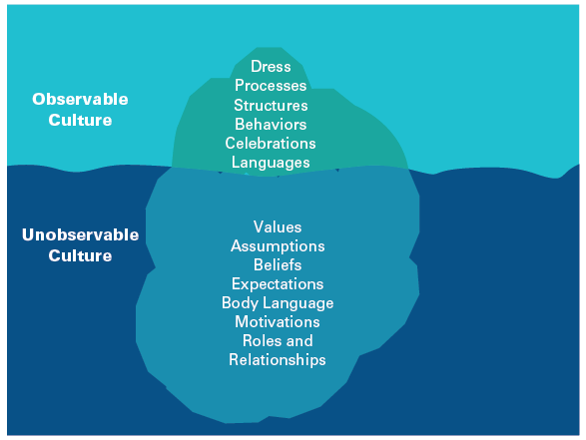
Components of Culture
Characteristics of Organizational Culture
Figure 14.1: The Cultural Iceberg: Components of Organizational Culture
SOURCE: Based on Hall, Edward T. Beyond Culture (Oxford: Anchor, 1976).
Notes:
Organizational culture can be subtle, with some of its components hidden beneath the surface. There are two main components: observable and unobservable.
Observable culture refers to the components of culture that we can see in an organization. For example, personal appearances and dress codes, processes and structures, behaviors and attitudes, and artifacts of the culture like awards, myths, and stories⁴ (described in more detail below in slide 4) are all observable parts of organizational culture. Unobservable culture consists of the components that lie beneath the surface of an organization, such as company values and assumptions. For instance, multinational food manufacturing company Kellogg integrates the following values within its organizational culture: passion, integrity, commitment and humility.6 While it is not easy to discern the extent of corporate values, they are often demonstrated in employee behaviors and attitudes. In some cases, assumptions and values can become so ingrained in the employees’ mindset that their perspectives and behaviors become difficult to change.

Slide 13
Google
Video

Slide 14
Observable Culture
Observable artifacts - manifestations of an organization’s culture that employees can easily see.
  Symbols - corporate logo, uniforms.
  Physical structures – buildings, offices.
  Language - jargon, slang, slogans.
  Stories – anecdotes, legends, myths.
  Rituals - planned routines.
  Ceremonies - formal events.
12-14

Slide 15
Unobservable Culture
Basic underlying assumptions – employees’ taken-for-granted beliefs.
  Are deeply ingrained in employees.
  Represent the least observable part of a culture.
  May not be apparent to employees.
  Have a strong influence on employee behavior and attitudes.
12-15

Slide 16
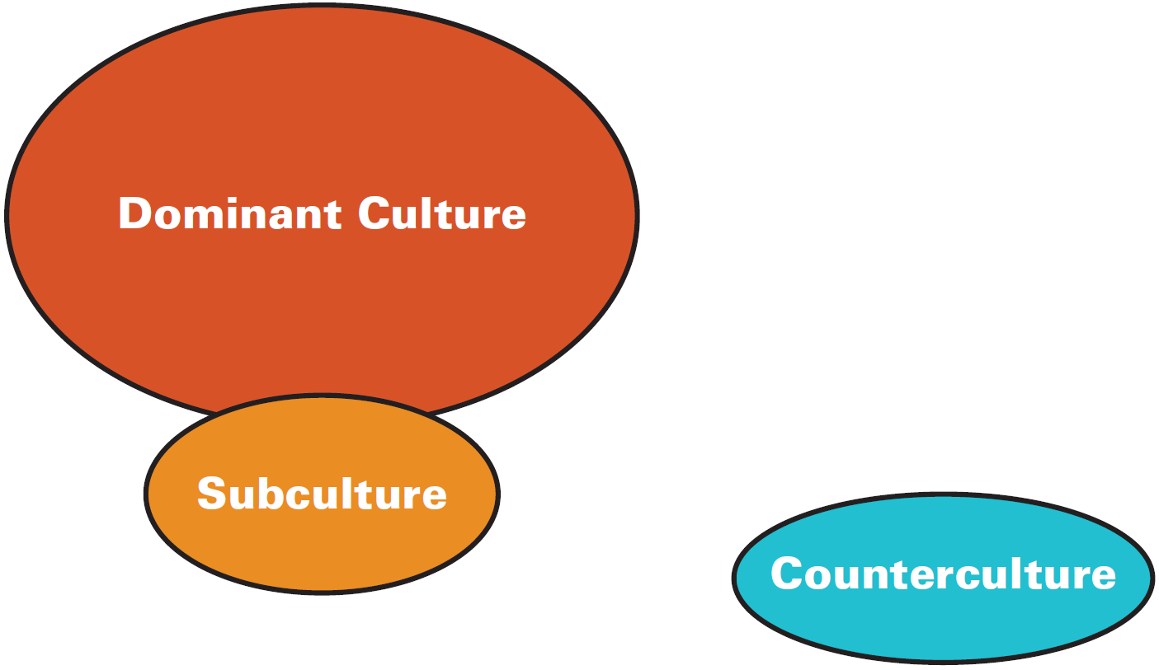
Dominant Culture, Subculture, and Counterculture
Characteristics of Organizational Culture
Figure 14.3: The Relationship Among Dominant Culture, Subculture, and Counterculture
Notes:
Every cultural group has its distinctions. The dominant culture is the set of core values shared by the bulk of organizational employees. So, for instance, travel website Tripadvisor places importance on donating to charity and giving back to the community, and members of the dominant culture are expected to do community work such as painting schools. In addition to this dominant culture, subcultures may spring up, which are groups in an organization that share different values from those held by the majority. For example, the Department of Defense consists of different branches such as the Army, Marines and the Navy. Overall, the dominant culture pervades, but each individual branch has its own subculture made up of unique characteristics. However, it is more common for subcultures to arise in companies where there is no dominant culture, or in the merger of two companies each of which has a different culture. An extreme type of subculture whose values strongly differ from those of the larger organization is a counterculture.¹⁶ Such groups openly reject the company’s values, embrace change, and challenge the status quo. It might seem that these “rebel” groups would be bad for an organization, but a counterculture can also produce positive results.

Slide 17
Strong and Weak Cultures
Characteristics of Organizational Culture
Strong cultures:
  Majority of employees are aligned with the values of an organization
  Less need for detailed policies and procedures
Weak cultures:
  Core values are not embraced or shared by its employees
  Core values are not defined or communicated well
Notes:
When the majority of employees are aligned with the values of an organization, it is clear that the organization has a strong culture because there is less need for detailed policies and procedures when the rules are accepted and understood.¹⁸ Successful furniture retailer Ikea is an organization with a strong company culture. Ikea prides itself on its limited bureaucracy and its emphasis on co-operation, respect, and teamwork among its employees.
In contrast, an organization with a weak culture is one whose core values are not embraced or shared by its employees. This occurs mainly because the core values are not defined or communicated well, which can lead to inconsistent behavior among employees, which in turn can lead to bad service. For example, following a number of security breaches at the White House, an independent culture investigation has shown that the culture of the U.S. Secret Service, largely based on organizational tradition and personal relationships, needs to achieve a culture change through new leadership.

Slide 18
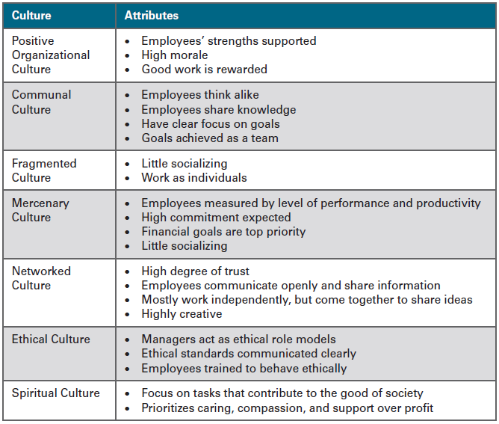
Types of Organizational Cultures
Figure 14.4: Organizational Cultures
Notes:
Earlier in this chapter, we explored the different types of organizational cultures, namely the adhocracy, clan, hierarchy, and market cultures, through the competing values framework. As we will see below, however, many more types of culture exist in the workplace.

Slide 19
Types of Organizational Cultures
Organizations with a positive organizational culture focus on supporting employees’ strengths, increasing morale, and providing rewards for good work.
Organizations that nurture a communal culture environment are home to employees who tend to think alike, are happy to share knowledge, and have a clear focus on the direction of the task
Notes:
Organizations with a positive organizational culture focus on supporting employees’ strengths, increasing morale, and providing rewards for good work. In this type of culture, employees are active in decision-making and kept informed of the organization’s vision and direction. Given this, they tend to be productive, engaged, and committed to the company.
Organizations that nurture a communal culture environment are home to employees who tend to think alike, are happy to share knowledge, and have a clear focus on the direction of the task. They are sociable and responsive and work well together to achieve goals. Southwest Airlines has created an informal culture that encourages staff to work together by pitching in and helping out where necessary.

Slide 20
Types of Organizational Cultures
Fragmented culture is found in companies where employees tend to keep to themselves, avoid socializing, and work as individuals rather than part of a team
Mercenary cultures exist in organizations where making money is the top priority.
Notes:
Fragmented culture is found in companies where employees tend to keep to themselves, avoid socializing, and work as individuals rather than part of a team. ³⁷ For example, computer programmers often spend long periods of time working alone, which may cause distance and disconnection from the rest of the group.
As the name suggests, mercenary cultures exist in organizations where making money is the top priority. Employees are measured by their levels of performance and productivity and are expected to have a high commitment towards achieving organizational goals. Since the culture is task-driven, they do not tend to socialize, which can sometimes result in an unfriendly working environment. Disgraced organization Enron is an example of a mercenary company that became ruthless in its quest to dominate new markets through a “win at all costs” attitude.

Slide 21
Types of Organizational Cultures
Networked cultures are characterized by a high degree of trust between employees and a willingness to communicate and share information
In an ethical culture managers need to be role models themselves, communicate ethical standards, and train employees to behave in an ethical manner
Notes:
Networked cultures are characterized by a high degree of trust among employees and a willingness to communicate and share information. Employees may work independently of each other, but they still come together on an informal basis to swap and exchange ideas. Highly creative organizations such as Google, Apple, and Pixar in which people are encouraged to think differently tend to have networked cultures.
Due to well-documented ethical scandals over the last few years, many organizations are moving toward creating more highly ethical cultures. This means managers need to be role models themselves, communicate ethical standards, and train employees to behave in an ethical manner. To reinforce this type of culture, employees should be rewarded for ethical behavior and punished for unethical behavior. An example of an organization with a strong ethical culture is science-based company 3M, which has been recognized by the Ethisphere Institute as the most ethical company in the world due to its strong commitment to the community and corporate citizenship.

Slide 22
Types of Organizational Cultures
Spiritual culture focuses on opportunities for employees to grow in the workplace by carrying out meaningful tasks that contribute to the good of society as a whole
Notes:
Spiritual culture focuses on opportunities for employees to grow in the workplace by carrying out meaningful tasks that contribute to the good of society as a whole. It prioritizes caring, compassion, and support for others over profit. There has been some debate over the effectiveness of spiritual organizations, with supporters believing that workplace spirituality enhances the value of the organization, and critics questioning the legitimacy of this type of culture, as well as its effectiveness in terms of profit and financial success.

Slide 23
Selection Practices
Shaping Organizational Culture
Person−organization fit refers to the process of selecting candidates whose personalities and attitudes best suite the organizational culture.
Notes:
Managers working in organizations with a certain culture tend to select candidates whose personalities and attitudes best match that culture and values. This match is called person−organization fit. Research has shown that hiring for organizational fit.

